Slide 1

How Machine Learning Helps in Financial Fraud Detection in the FinTech Industry

Slide 2
What Is Fraud Detection?
Fraud detection is a set of activities undertaken to prevent money or property from being obtained through false pretenses. Fraud is a highly adaptable and technologically sophisticated crime.
Fraud detection affects various businesses, including banking and finance, healthcare,insurance and so on.
The rule-based technique of fraud detection may detect obvious fraudulent instances but takes a long time to process with a lot of human labor.
When we talk about big data, the instruments for detecting and combating fraud should become increasingly sophisticated. Knowledge Discovery in Databases (KDD), Machine Learning, and Statistics are methodologies for fraud detection systems.

Slide 3
Why use machine learning for fraud detection?
Fraud detection machine learning models are more effective than humans: machine learning algorithms detect patterns in financial operations and decide whether a given transaction is legitimate.
ML handles overload well
ML beats traditional fraud detection systems: It can beat traditional fraud detection systems in terms of speed, quality, and cost-effectiveness.

Slide 4
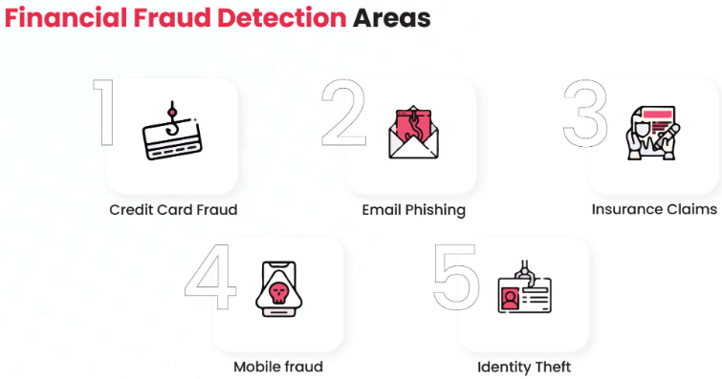
5 Major Areas Of Financial Fraud In The Finance Sector

Slide 5
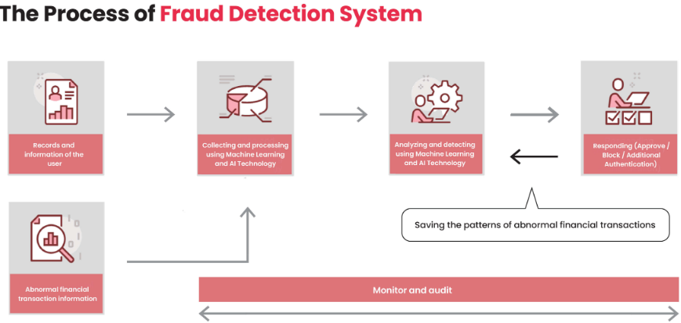
How To Build Fraud Detection In Fintech Using Machine Learning?

Slide 6
Machine Learning Models And Algorithms For Detecting Financial Fraud
The following are the many types of machine learning models and algorithms used in the finance industry to detect financial fraud ;
Supervised Learning
Unsupervised Learning
Semi-Supervised Learning
Reinforcement Learning

Slide 7

How Does A Machine Learning Model Identify Fraud Detection?
Input Data: The more data an ML model receives, the better it can learn and polish its fraud detection skills.
Extract Features: These features usually include the customer’s location, identity, orders, network, and chosen payment method.
Train Algorithm: This algorithm is a set of rules that an ML model has to follow when deciding whether an operation is legitimate or fraudulent.
Build A Model: It can detect fraud in next to no time with high accuracy.

Slide 8
Advantages of using Machine Learning in Fraud detection
Automatic fraud pattern recognition - the task of figuring out what makes a fraud is handled by the algorithm.
Concept drift defined as a change in fraud characteristics in time (new fraud methods, new tools used by fraudsters) often can be solved by retraining the models on new data — there’s no need to reverse engineer fraudsters’ methods.
Less manual work involved
The return on developing automated fraud detection using ML models thus increases as data volume increases.

Slide 9
Conclusion
When it comes to Fraud Prevention, organisations adapt to and employ Machine Learning systems that can deliver a powerful, cost-effective, and real-time solution before fraud takes place.
Machine learning enables the development of increasingly complicated algorithms for assessing various transactions and questionable financial behavior, hence reducing the risk of financial loss.

